Slide 1

“A Brand New Year,
A Brand New YOU!”
Make 2016 the Year You Finally
Get To Enjoy the Happy, Healthy Smile You Deserve

Slide 2
You Don’t Have to Suffer Any More…
There’s real pain when you have missing or broken teeth
When you're afraid to smile, or you're always in pain, your whole life is affected.
It's impossible to live life to its fullest when you're always self-conscious about your teeth.
But now there’s a simple, easy, and awesome solution: Dental Implants.

Slide 3
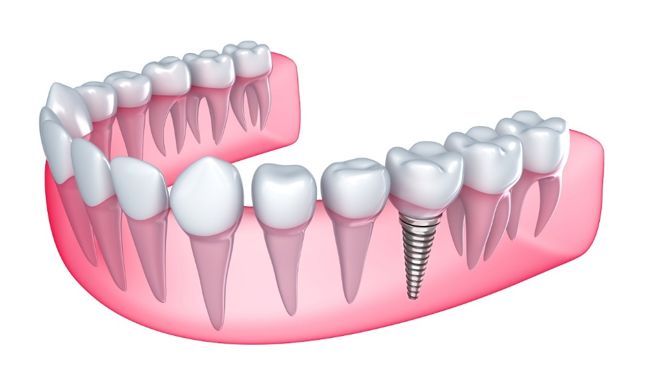
Implants Make It EASY To Have a Brand New You
A Dental Implant is a simple procedure, and the results look and feel just like a real tooth.
This means that you’ll have the bright, shining smile you’ve wanted and deserved.

Slide 4
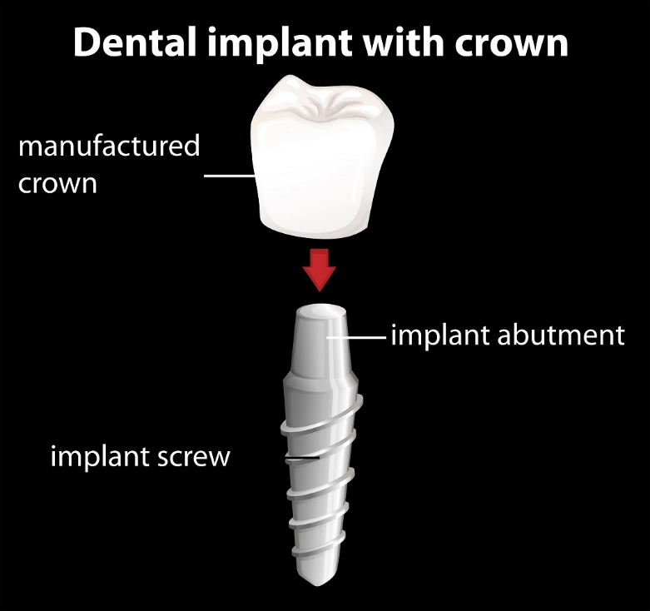
How This Works…
Custom replacement tooth root is fitted for you from high quality titanium alloy.
We craft the upper, visible portion of your implant to match your existing teeth.
The implant’s artificial root gradually integrates with your jawbone – it works, looks, and feels like a REAL tooth.
Improves bone health, stabilizes your mouth, and restores your natural beauty.

Slide 5
How Your Life Will Change For the Better…
No more pain during eating, discomfort throughout the day, or hassle removing and replacing false teeth.
You’ll look and feel younger with a healthy, complete, vibrant smile.
Dental implants prevent bone loss that coincides with tooth loss.

Slide 6
How Your Life Will Change For the Better…
Your jaw remains strong and intact, retaining your true face shape, and keeping your natural, shining beauty.
Healthy foods you’ve missed are back on the menu and you can once again enjoy those mouthwatering favorites every day.
With a full, functional, glowing smile you’ll see a renewed sense of confidence in every aspect of your life.

Slide 7
Frequently Asked Questions
Is the process painful?
  Patients say “it’s pain free.” Your entire procedure is completed quickly under local anesthesia.
Does it require special maintenance?
  Just brush and floss like a normal tooth.
How much time does it take?
  For just one single implant, your placement is completed in about an hour at the office.

Slide 8
Frequently Asked Questions
How long will it last?
  They can last a lifetime.
How long does it take to heal?
  Your new implant will take 8-16 weeks to fully integrate with the jawbone.
How can I know if I’m a good candidate?
  If you’re missing one or more teeth, or if you have a failing tooth that will require extraction, dental implants may be the perfect solution.

Slide 9

FREE “Happy New Year, Happy Smile”
Implant Consultation

Slide 10
You CAN Get Results Like These…
INSERT TESTIMONIALS FROM HAPPY CLIENTS, ONE PER SLIDE
INCLUDE BEFORE AND AFTER PICTURES IF POSSIBLE.

Slide 11
Schedule Your FREE “Happy New Year,
Happy Smile” Implant Consultation TODAY.

